Slide 1
Health and Nutrition module

Slide 2
Subjects
Food
Personal Hygiene
General Hygiene
Common Diseases
Other..

Slide 3

Food
What is healthy food?

Slide 4
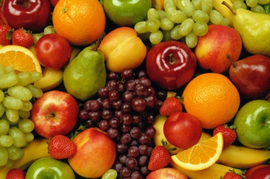
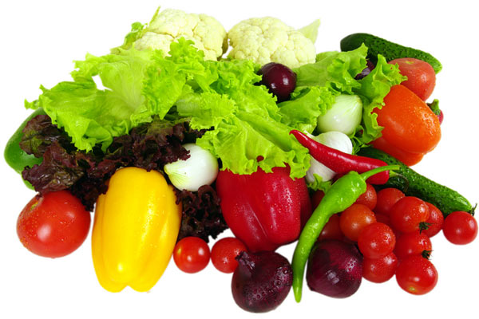
Fruits and Vegetables

Slide 5
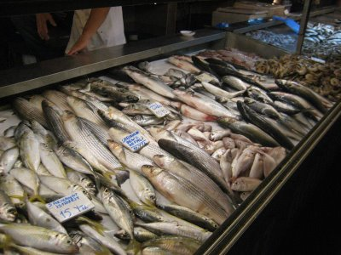
Fish

Slide 6
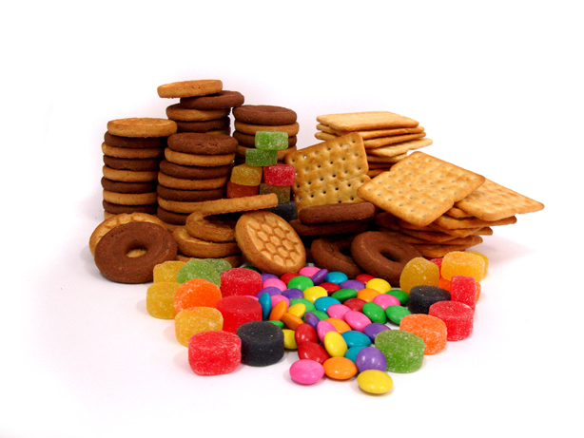
Too much candy is not healthy!

Slide 7
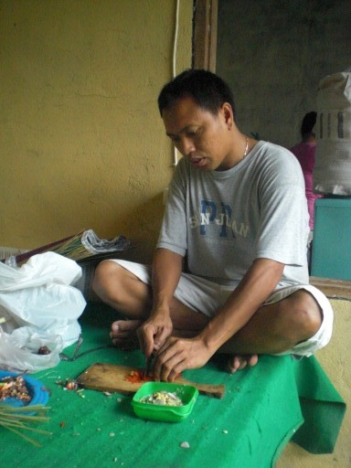
Preparation of food
Use clean utensils
Keep raw meat and other foods seperate

Slide 8

Personal Hygiene
What is the importance of personal hygiene?

Slide 9
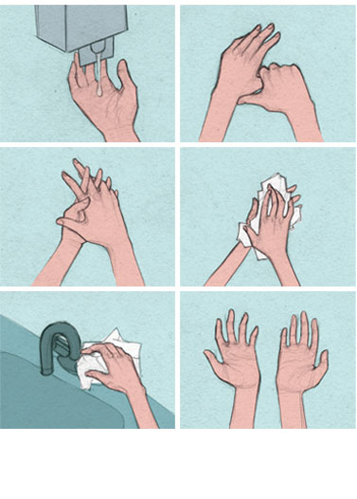
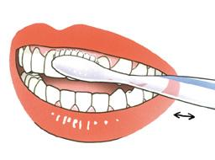
Personal Hygiene
Brush your teeth every day
Often wash your hands

Slide 10
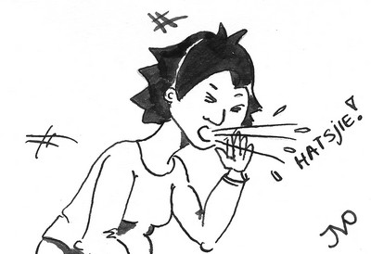
Coughing and Sneezing
Always cover your mouth when you sneeze!

Slide 11

What is general hygiene?
And why is it so important?

Slide 12
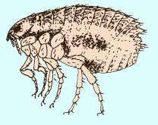
General Hygiene
Clean the house
Be carefull when playing with dogs and cats
Do not play in the garbage

Slide 13
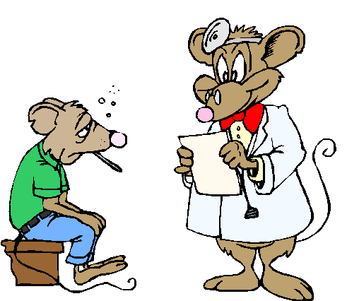
Common Diseases
Which common diseases do you know?

Slide 14
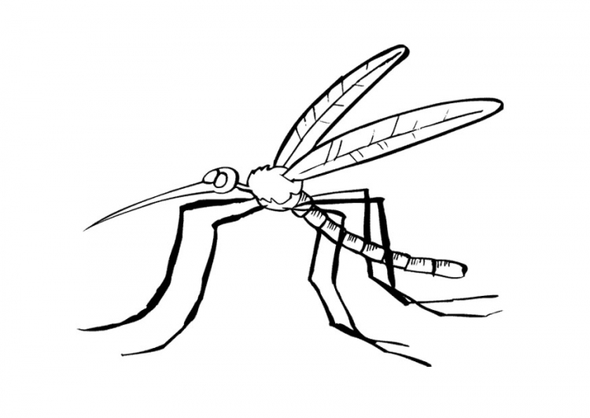
Common Diseases
Dengue
Malaria
Diarrhea

Slide 15

Other..

